Slide 1
Delivery Delay Analysis
PROJECT - 2
MADE BY – UDITYA SETH
ROLL NO – 2312RES962

Slide 2
Introduction
In the competitive world of e-commerce and online services, timely deliveries play a crucial role in customer satisfaction and business success.
However, various factors such as geographical zones, traffic congestion, and weather conditions can lead to delays.
Understanding these patterns is essential for improving delivery efficiency and resource planning.
This project, "Delivery Delay Analysis Using Power BI", aims to analyze real order data to identify the zones and time slots that experience the most delivery delays.
By visualizing these delays alongside weather conditions, businesses can pinpoint problem areas and take targeted actions to optimize operations.
Objective
To calculate delivery delay duration by comparing scheduled and actual delivery times.
To identify the top 5 zones with the highest average delivery delays.
To analyze delay trends across different time slots of the day.
To study the impact of weather conditions on delivery performance.
To create interactive Power BI dashboards using bar charts, heatmaps, and slicers for easy exploration of data.
To provide actionable insights that help improve delivery planning and reduce late deliveries.

Slide 3
# PROCESS
1 I HAVE GENERATE DATA SET
THEN ACCORDING TO INSTRUCTIONS
I HAVE CLEAN IT
THEN I HAVE ADD A CUSTOMIZED DELAY COLOUMN IN MY DATA SET
THEN I HAVE ADD A NEW MEASURE OF TIMESLOT IN MY DATA SET
THEN I HAVE USE A STACK COLOUMN CHART WHICH SHOW THE DELAY OF DELIVERY DUE TO WEATHER CONDITION
THEN I HAVE USE A CLUSTER BAR CHART WHICH SHOW DELIVERY DELAY ZONE WISE
THEN I HAVE USE A CLUSTERED COLOUMN CHART WHICH SHOW DELAY OF DELIVERY ACCORDING TIME SLOT
THEN I HAVE USE A STACK BAR CHART WHICH SHOW DELAY OF DELIVERY IN ZONE WISE DUE TO WEATHER CONDITION
THEN I HAVE USE A WATERFALL CHART WHICH SHOW DELAY OF DELIVERY ZONE WISE AND TIME SLOT
THEN I HAVE USE A HEATMAP WHICH SHOW DELAY OF DELIVERY WITH TIME SLOT DUE TO WEATHER CONDITION
AT LAST I HAVE USE A SLICER WHICH INCLUDED WEATHER , TIME ZONE AND TIME SLOT

Slide 4
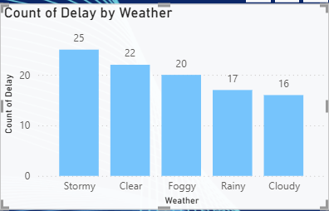
DELIVERY DELAY DUE TO WEATHER

Slide 5
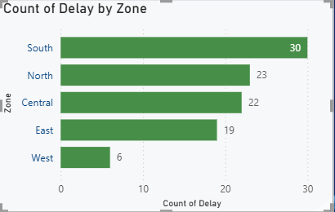
DELAY OF DELIVERY ZONE WISE

Slide 6
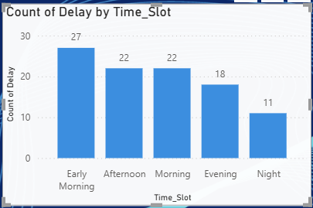
DELAY OF DELIVERY BY TIME SLOT

Slide 7
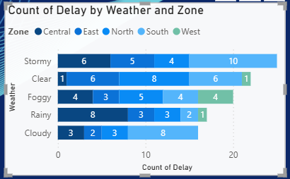
DELAY OF DELIVERY ZONE WISE DUE TO WEATHER

Slide 8
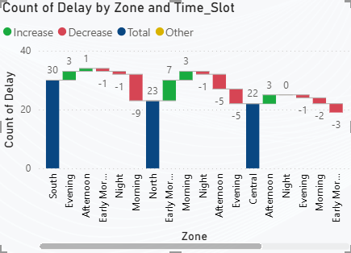
DELAY OF DELIVERY IN DIFFERENT TIME SLOT AT DIFFERENT ZONE

Slide 9
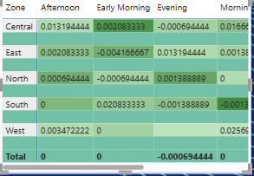
DELAY OF DELIVERY SHOWN BY HEAT MAP

Slide 10
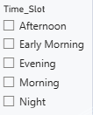


SLICERS WHICH I HAVE USE ACCORDING TO PROJECT

Slide 11
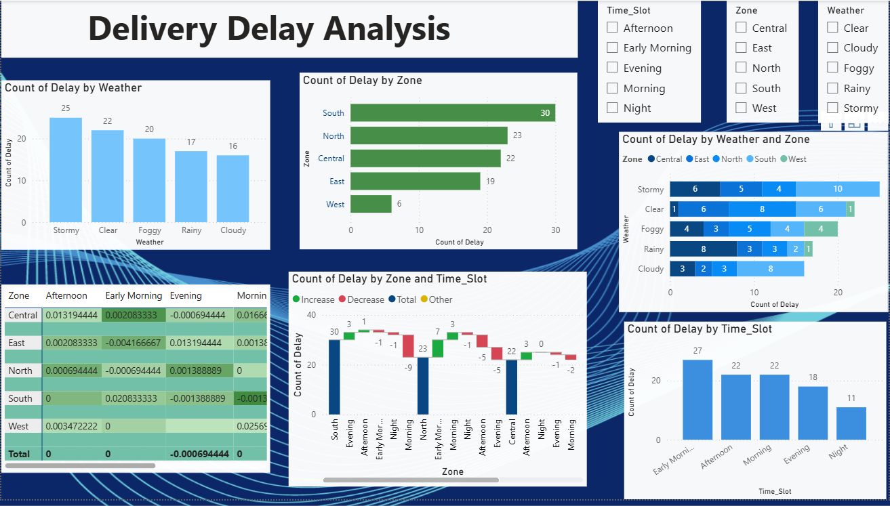
DASHBOARD

Slide 12
THANK YOU

